Slide 1
Testing Goodness-of-Fit for a Single Categorical Variable
Section 7.1
Kari Lock Morgan

Slide 2
Multiple Categories
So far, we’ve learned how to do inference for categorical variables with only two categories
Today, we’ll learn how to do hypothesis tests for categorical variables with multiple categories

Slide 3

Rock-Paper-Scissors (Roshambo)

Slide 4
Rock-Paper-Scissors
ROCK | PAPER | SCISSORS
66 | 39 | 14
How would we test whether all of these categories are equally likely?

Slide 5
Hypothesis Testing
State Hypotheses
Calculate a statistic, based on your sample data
Create a distribution of this statistic, as it would be observed if the null hypothesis were true
Measure how extreme your test statistic from (2) is, as compared to the distribution generated in (3)
test statistic

Slide 6
Hypotheses
Let p_{i} denote the proportion in the i^{th} category.
H₀ : All p_{i} s are the same
H_{a} : At least one p_{i} differs from the others
OR
H₀ : Every p_{i} = 1/3
H_{a} : At least one p_{i} ≠ 1/3

Slide 7
Test Statistic
Why can’t we use the familiar formula
to get the test statistic?
More than one sample statistic
More than one null value
We need something a bit more complicated…

Slide 8
Observed Counts
The observed counts are the actual counts observed in the study
 | ROCK | PAPER | SCISSORS
Observed | 66 | 39 | 14

Slide 9
Expected Counts
The expected counts are the expected counts if the null hypothesis were true
For each cell, the expected count is the sample size (n) times the null proportion, p_{i}

Slide 10
Rock-Paper-Scissors
 | ROCK | PAPER | SCISSORS
Observed | 66 | 39 | 14
Expected
Notes:
n = 119
39.7

Slide 11
Chi-Square Statistic
A test statistic is one number, computed from the data, which we can use to assess the null hypothesis
The chi-square statistic is a test statistic for categorical variables:

Slide 12
Rock-Paper-Scissors
 | ROCK | PAPER | SCISSORS
Observed | 66 | 39 | 14
Expected | 39.7 | 39.7 | 39.7
Notes:
17.42 + .01 + 16.64 = 34.07

Slide 13
What Next?
We have a test statistic. What else do we need to perform the hypothesis test?
A distribution of the test statistic assuming H₀ is true
How do we get this?
Two options:
    Simulation
    Distributional Theory

Slide 14
Upper-Tail p-value
To calculate the p-value for a chi-square test, we always look in the upper tail
Why?
  Values of the χ² are always positive
  The higher the χ² statistic is, the farther the observed counts are from the expected counts, and the stronger the evidence against the null

Slide 15
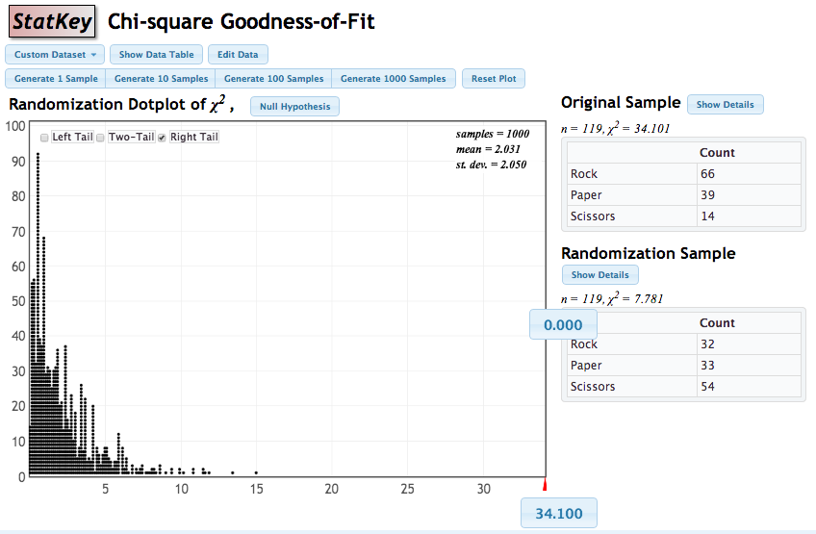
Simulation
www.lock5stat.com/statkey

Slide 16
Chi-Square (χ²) Distribution
If each of the expected counts are at least 5, AND if the null hypothesis is true, then the χ² statistic follows a χ² –distribution, with degrees of freedom equal to
df = number of categories – 1
Rock-Paper-Scissors:
df = 3 – 1 = 2

Slide 17
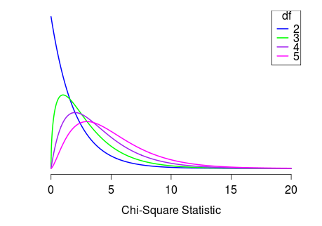
Chi-Square Distribution

Slide 18
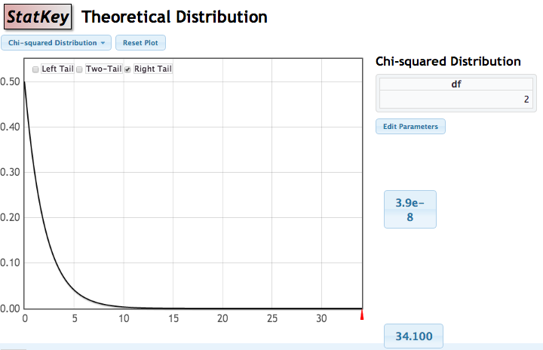
p-value using χ² distribution
www.lock5stat.com/statkey

Slide 19
Goodness of Fit
A chi-square test for goodness of fit tests whether the distribution of a categorical variable is the same as some null hypothesized distribution
The null hypothesized proportions for each category do not have to be the same

Slide 20
Chi-Square Test for Goodness of Fit
State null hypothesized proportions for each category, p_{i}. Alternative is that at least one of the proportions is different than specified in the null.
Calculate the expected counts for each cell as np_{i} .
Calculate the χ² statistic:
Compute the p-value as the proportion above the χ² statistic for either a randomization distribution or a χ² distribution with df = (# of categories – 1) if expected counts all > 5
Interpret the p-value in context.
Notes:
n = 1

Slide 21
Mendel’s Pea Experiment
In 1866, Gregor Mendel, the “father of genetics” published the results of his experiments on peas
He found that his experimental distribution of peas closely matched the theoretical distribution predicted by his theory of genetics (involving alleles, and dominant and recessive genes)
Source: Mendel, Gregor. (1866). Versuche über Pflanzen-Hybriden. Verh. Naturforsch. Ver. Brünn 4: 3–47 (in English in 1901, Experiments in Plant Hybridization, J. R. Hortic. Soc. 26: 1–32)

Slide 22
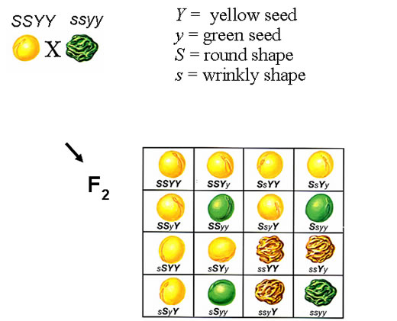
Mendel’s Pea Experiment
Mate SSYY with ssyy:
1st Generation: all Ss Yy
  Mate 1st Generation:
  => 2nd Generation
← Second Generation
Phenotype | Theoretical Proportion
Round, Yellow | 9/16
Round, Green | 3/16
Wrinkled, Yellow | 3/16
Wrinkled, Green | 1/16
S, Y: Dominant
s, y: Recessive

Slide 23
Mendel’s Pea Experiment
Phenotype | Theoretical Proportion | Observed Counts
Round, Yellow | 9/16 | 315
Round, Green | 3/16 | 101
Wrinkled, Yellow | 3/16 | 108
Wrinkled, Green | 1/16 | 32
Let’s test this data against the null hypothesis of each p_{i} equal to the theoretical value, based on genetics

Slide 24
Mendel’s Pea Experiment
Phenotype | Null p_{i} | Observed Counts | Expected Counts
Round, Yellow | 9/16 | 315
Round, Green | 3/16 | 101
Wrinkled, Yellow | 3/16 | 108
Wrinkled, Green | 1/16 | 32
Notes:
n = 556
Expected = 312.75, 104.25, 104.25, 34.75
chisquare = 0.47

Slide 25
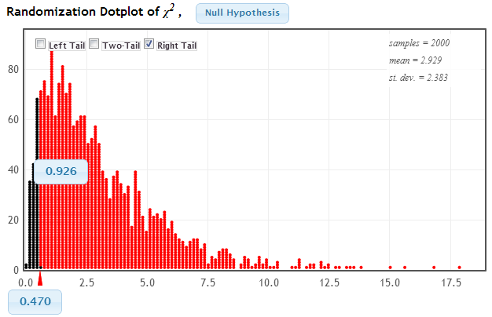
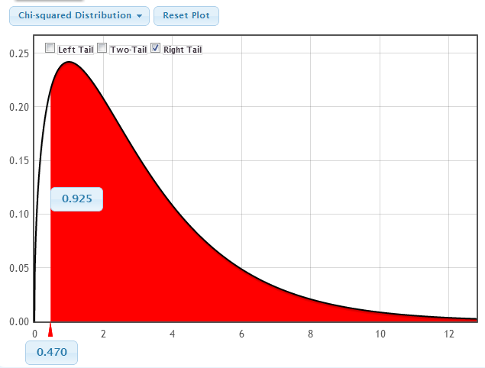
Mendel’s Pea Experiment
χ² = 0.47
Two options:
  Simulate a randomization distribution
  Compare to a χ² distribution with 4 – 1 = 3 df

Slide 26
Mendel’s Pea Experiment
p-value = 0.925
Does this prove Mendel’s theory of genetics? Or at least prove that his theoretical proportions for pea phenotypes were correct?
Yes
No

Slide 27
Chi-Square Goodness of Fit
You just learned about a chi-square goodness of fit test, which compares a single categorical variable to null hypothesized proportions for each category:
Find expected (if H₀ true) counts for each cell: np_{i}
Compute χ² statistic to measure how far observed counts are from expected:
Compare χ² statistic to χ² distribution with (df = # categories – 1) or randomization distribution to find upper-tailed p-value

Slide 28
ADHD or Just Young?
In British Columbia, Canada, the cutoff date for entering school in any year is December 31st, so those born late in the year are younger than those born early in the year
Are children born late in the year (younger than their peers) more likely to be diagnosed with ADHD?
Study on 937,943 children 6-12 years old in British Columbia
Morrow, R., et. al., “Influence of relative age on diagnosis and treatment of attention-deficit/hyperactivity disorder in children,” Canadian Medical Association Journal, April 17, 2012; 184(7): 755-762.

Slide 29
ADHD or Just Young? (BOYS)
Birth Date | Proportion of Births
Jan-Mar | 0.244
Apr-Jun | 0.258
Jul-Sep | 0.257
Oct-Dec | 0.241

Slide 30

ADHD or Just Young? (BOYS)
Birth Date | Proportion of Births | ADHD Diagnoses | Expected Counts | Contribution to χ²
Jan-Mar | 0.244 | 6880
Apr-Jun | 0.258 | 7982
Jul-Sep | 0.257 | 9161
Oct-Dec | 0.241 | 8945
Notes:
n = 32,968
Expected: 8044.2, 8505.7, 8472.8, 7945.3
Chi-square: 168.5 + 32.2 + 55.9 + 125.8 = 382.4

Slide 31
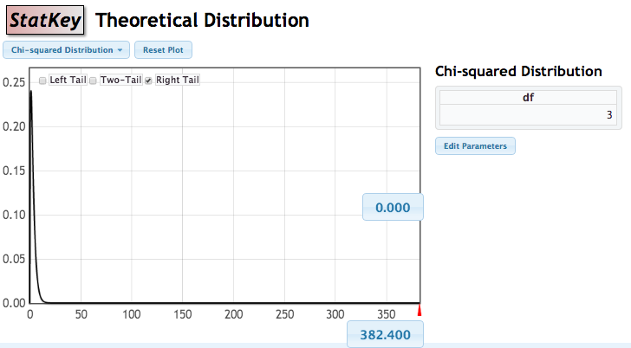
ADHD or Just Young (Boys)
p-value ≈ 0
We have VERY (!!!) strong evidence that boys who are born later in the year, and so are younger than their classmates, are more likely to be diagnosed with ADHD.

Slide 32
ADHD or Just Young? (Girls)
Want more practice?
Here is the data for girls. (χ² = 236.8)
Birth Date | Proportion of Births | ADHD Diagnoses
Jan-Mar | 0.243 | 1960
Apr-Jun | 0.258 | 2358
Jul-Sep | 0.257 | 2859
Oct-Dec | 0.242 | 2904

Slide 33
Testing for an Association between Two Categorical Variables
Section 7.2
Kari Lock Morgan

Slide 34
Review: Chi-Square Goodness of Fit
In the last section, a chi-square goodness of fit test, which compares a single categorical variable to null hypothesized proportions for each category:
Observed counts from data
Find expected (if H₀ true) counts for each cell
Compute χ² statistic to measure how far observed counts are from expected:
Compare χ² statistic to χ² distribution to find upper-tailed p-value

Slide 35
Two Categorical Variables
The statistics behind a χ² test easily extends to two categorical variables
A χ² test for association (often called a χ² test for independence) tests for an association between two categorical variables
Everything is the same as a chi-square goodness-of-fit test, except:
  The hypotheses
  The expected counts
  Degrees of freedom for the χ²-distribution

Slide 36

Award Preference & SAT
The data in StudentSurvey includes two categorical variables:
Award = Academy, Nobel, or Olympic
HigherSAT = Math or Verbal
Do you think there is a relationship between the award preference and which SAT is higher? If so, in what way?

Slide 37
Award Preference & SAT
HigherSAT | Academy | Nobel | Olympic | Total
Math | 21 | 68 | 116 | 205
Verbal | 10 | 79 | 61 | 150
Total | 31 | 147 | 177 | 355
Data are summarized with a 2×3 table for a sample of size n=355.
H₀ : Award preference is not associated with which SAT is higher
H_{a} : Award preference is associated with which SAT is higher
If H₀ is true ⟹ The award distribution is expected to be the same in each row.

Slide 38
Expected Counts
HigherSAT | Academy | Nobel | Olympic | Total
Math | 21 | 68 | 116 | 205
Verbal | 10 | 79 | 61 | 150
Total | 31 | 147 | 177 | 355
HigherSAT | Academy | Nobel | Olympic | Total
Math |  |  |  | 205
Verbal |  |  |  | 150
Total | 31 | 147 | 177 | 355
Note: The expected counts maintain row and column totals, but redistribute the counts as if there were no association.

Slide 39
Chi-Square Statistic
HigherSAT | Academy | Nobel | Olympic | Total
Math | 21 (17.9) | 68 (84.9) | 116 (102.2) | 205
Verbal | 10 (13.1) | 79 (62.1) | 61 ( 74.8) | 150
Total | 31 | 147 | 177 | 355
HigherSAT | Academy | Nobel | Olympic
Math
Verbal

Slide 40
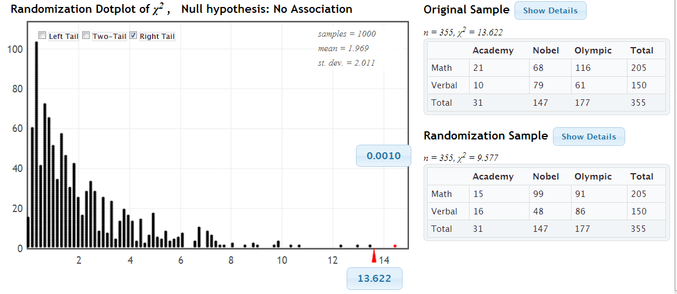
Randomization Test
www.lock5stat.com/statkey
p-value=0.001 ⟹ Reject H₀
We have evidence that award preference is associated with which SAT score is higher.

Slide 41
Chi-Square (χ²) Distribution
If each of the expected counts are at least 5, AND if the null hypothesis is true, then the χ² statistic follows a χ² –distribution, with degrees of freedom equal to
df = (number of rows – 1)(number of columns – 1)
Award by HigherSAT:
df = (2 – 1)(3 – 1) = 2

Slide 42
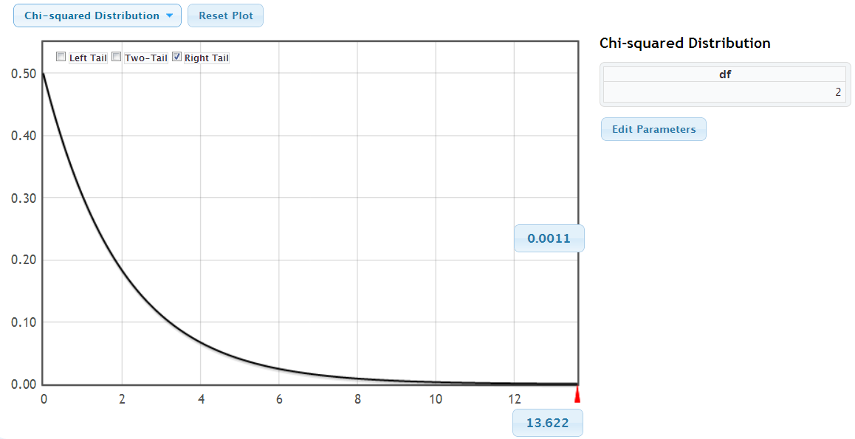
Chi-Square Distribution
For Higher SAT vs. Award: df = (2 – 1)(3 – 1) = 2
We have evidence that award preference is associated with which SAT score is higher.

Slide 43
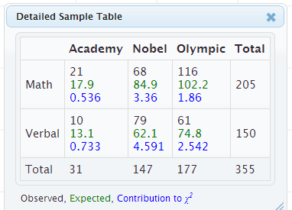
Chi-Square Test for Association
Note: The χ²-test for two categorical variables only indicates if the variables are associated. Look at the contribution in each cell for the possible nature of the relationship.

Slide 44
Chi-Square Test for Association
H₀ : The two variables are not associated
H_{a} : The two variables are associated
Calculate the expected counts for each cell:
Calculate the χ² statistic:
Compute the p-value as the area in the tail above the χ² statistic using either a randomization distribution, or a χ² distribution with df = (r – 1) (c – 1) if all expected counts > 5
Interpret the p-value in context.

Slide 45

Metal Tags and Penguins
Are metal tags detrimental to penguins? A study looked at the 10 year survival rate of penguins tagged either with a metal tag or an electronic tag. 20% of the 167 metal tagged penguins survived, compared to 36% of the 189 electronic tagged penguins.
Is there an association between type of tag and survival?
Source: Saraux, et. al. (2011). “Reliability of flipper-banded penguins as indicators of climate change,” Nature, 469, 203-206.

Slide 46
Metal Tags and Penguins
State Hypotheses
H₀: Type of tag and survival are not associated
H_{a}: Type of tag and survival are associated

Slide 47
Metal Tags and Penguins
Create two-way table of observed counts
Tag\Survival | Survived | Died | Total
Metal
Electronic
Total
20% of the 167 metal tagged penguins survived, compared to 36% of the 189 electronic tagged penguins.

Slide 48
Metal Tags and Penguins
Calculate expected counts
Tag\Survival | Survived | Died | Total
Metal |  |  | 167
Electronic |  |  | 189
Total | 101 | 255 | 356

Slide 49
Metal Tags and Penguins
Calculate chi-square statistic
 | Survived | Died
Metal Tag | 33 (47.4) | 134 (119.6)
Electronic Tag | 68 (53.6) | 121 (135.4)
 | Survived | Died
Metal Tag
Electronic Tag

Slide 50
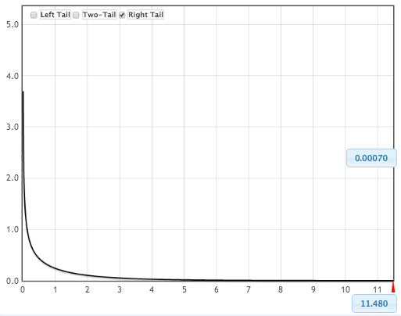
Metal Tags and Penguins
Compute p-value and interpret in context.
p-value = 0.0007
(using a χ²-distribution with 1 df)
There is strong evidence of an association between type of tag and survival of penguins, with electronically tagged penguins having better survival than metal tagged.

Slide 51
2 x 2 Table
Note: because each of these variables only has two categories, we could have done this as a difference in proportions test
We would have gotten the exact same p-value!
For two categorical variables with two categories each, can do either difference in proportions or a chi-square test

Slide 52
Summary: Chi-Square Tests
The χ² goodness-of-fit tests if one categorical variable differs from a null distribution
The χ² test for association tests for an association between two categorical variables
For both, you compute the expected counts in each cell (assuming H₀) and the χ² statistic:
Find the proportion above the χ² statistic in a randomization or χ²-distribution (if all expected counts > 5)

