Slide 1
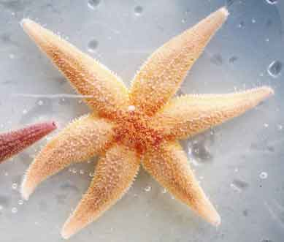
Echinodermata
General characteristics

Slide 2
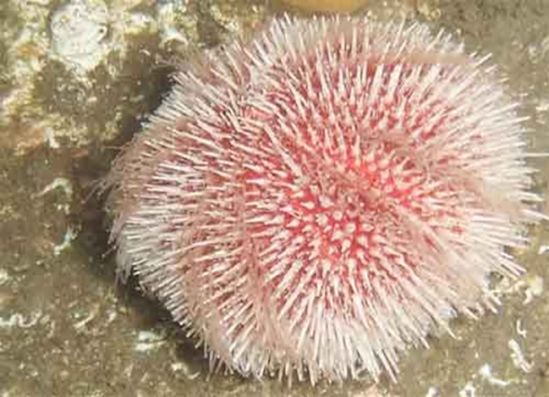
Unit 2&3: Echinodermata
General characteristics and Classification
upto classes
Water-vascular system inAsteroidea
Note:Classification to be followed from ―Ruppert and Barnes (2006)
Invertebrate Zoology, 8th edition, Holt Saunders International Edition‖

Slide 3
INTRODUCTION
The word Echinodermata has been derived
from the Greek word Echinos = Rough or Spiny and Derma = Skin
Members of this phylum have uneven or spiny skin

Slide 4
GENERAL CHARACTERS
Habitat: All the existing echinoderms are marine. They generally live at the bottom of the sea. Most of them are pelagic (free swimming in open water) and few are sessile (attached to the substratum). Grade of organization: organ system grade
Germ layer: triploblastic
Symmetry: Adults are radially symmetrical while the larvae are bilaterally symmetrical.
Coelom: present ( coelomate)
Body without segmentation

Slide 5
GENERAL CHARACTERS
6.The shape of the body is flat, star like, spherical or elongated.
7.Head is absent
8.Presence of tube feet
9.Presence of water vascular system
10.Mouth is present on ventral side while anus is present on dorsal side
11.Respiration: by papule, gills or clocal respiratory tree
12.Nervous system is poorly developed. Brain is absent.

Slide 6
GENERAL CHARACTERS
13.Circulatory system is reduced and heart is absent.
14.Blood has no pigment.
15.Digestive system: complete in most members.
16.Excretory system: absent.
17.Sexes: mostly dioecious, rarely monocious
18.Reproduction: Sexual: by gamatic fusion;Asexual: regeneration
19.Fertilization: external
20.Development: indirect with characteristic larvae

Slide 7
Symmetry
The larva is bilateral but adults are pentamerous radial symmetrical.
Body parts are arranged in five or multiple of five.
Body Colour
Echinoderms also exhibit especially brilliant colours such as reds, oranges, greens, and purples. Many tropical species are dark brown to black, but lighter colours, particularly yellows, are common among species not normally exposed to strong sunlight.

Slide 8
Body Wall
Epidermis is single layered and ciliated.
In many echinoderms there is endoskeleton of calcareous plates in the dermis, which are mesodermal in origin.

Slide 9
Ambulacral / Water Vascular System
It is characteristic feature of this phylum.
This system is of coelomic origin.
It consists of a chain of different tubes or canals attached with each other. It starts from a perforated plate called madreporite and ends into tube feet.
All the canals are filled with the fluid or sea water and subsequently helps in locomotion.

Slide 10
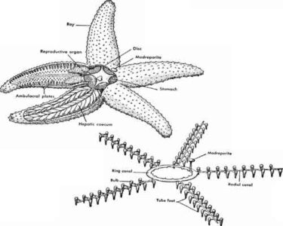

Slide 11
Digestive System
The mouth is located on the ventral side (oral side).
Usually complete digestive system is present, having two stomach cardiac and pyloric stomach. In some species such as a brittle star, it is incomplete.
Cardiac stomach can come out of the mouth during the capture of the prey.
Echinoderms feed in a variety of ways. A distinct feeding rhythm frequently occurs, with many forms feeding only at night, others feeding continuously. Feeding habits range from active, selective predation to omnivorous scavenging or nonselective mud swallowing.

Slide 12
Circulatory system
open type blood circulatory system with five radiating vessels.
Instead of blood vascular system, the haemal & perihaemal system represent the open circulatory system.
Blood has no respiratory pigment .
Heart is absent.

Slide 13
Respiratory Organs
Different types of respiratory organs are found in different echinoderms such as dermal branchiae or papulae in starfish, genital bursae in the brittle star, peristominal gills in sea urchin and cloacal respiratory trees in Holothurians.
In star fishes there are dermal branchae for the gaseous exchange.
It is finger like, thin walled elongated tubular structure present on the aboral surface, filled with coelomic fluid. These fluid exchange the gases through the semipermeable dermal branchia.

Slide 14
Excretory Organs
Specialized excretory organs are absent.
Nitrogenous wastes are diffused out via gills. Ammonia is chief excretory matter.

Slide 15
Nervous System
It consists of a nerve ring and radial nerve cords.
Brain is absent.
Poorly developed sense organs are found (tactile organs, terminal tentacles, chemoreceptors, etc).

Slide 16
Reproduction and life cycle
In most species the sexes are separate.
Fertilization is usually external. Although reproduction is usually sexual, involving fertilization of eggs by spermatozoa, several species of sea cucumbers, starfishes, and brittle stars can also reproduce asexually.
In sexual reproduction, eggs (up to several million) from females and spermatozoa from males are shed into the water (spawning), where the eggs are fertilized.
Asexual reproduction in echinoderms usually involves the division of the body into two or more parts (fragmentation) and the regeneration of missing body parts. Fragmentation is a common method of reproduction used by some species of asteroids, ophiuroids, and holothurians, and in some of these species sexual reproduction is not known to occur.

Slide 17
Development
Indirect
It includes a ciliated,bilaterally symmetrical larva that undergoes metamorphosis to change into the radially symmetrical adult.
Various larval forms are found such as Bipinnaria, Brachiolaria (starfish), Pluteus (sea urchin), Auricularia (sea cucumber), Ophioputeus (brittle star), and Doliolaria (feather star).

Slide 18
Degenerated Characters
Lack of head
Simple sense organs
Incomplete digestive tract in some forms
Reduced circulatory system
Absence of excretory system

Slide 19
REFERENCES
https://www.britannica.com/video/22238/Echinoderms-body-plans-variety-starfishes-some-sea
Invertebrates R.L. Kotpal

