Slide 1
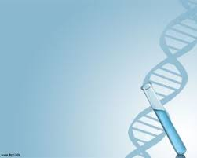
Nucleic Acids
For 5th Sem

Slide 2
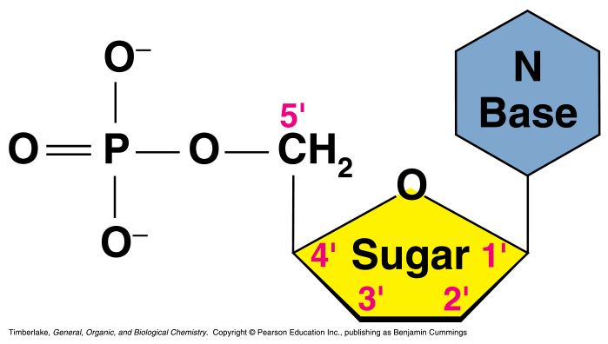
Nucleic Acids
Nucleic acids are molecules that store information for cellular growth and reproduction.
Nucleic acids are polymers of nucleotides
Types of nucleic acid-
a) Deoxyribonucleic acid (DNA)
b) ribonucleic acid (RNA)
A nucleotide consists of a nitrogenous base, a pentose sugar and a phosphate group:

Slide 3
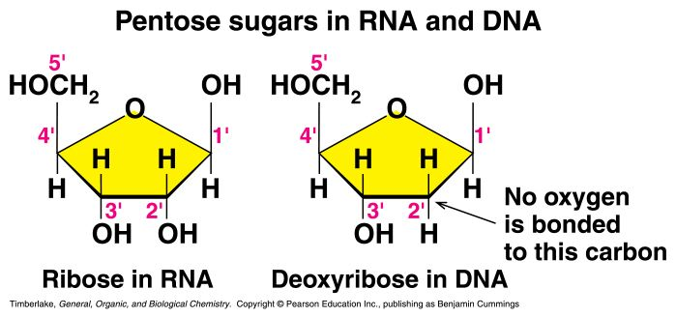
Sugars
5 carbon keto sugar or pentose
There are two related pentose sugars:
- RNA contains ribose
- DNA contains deoxyribose
Both sugar are present in furanose form
The sugars have their carbon atoms numbered with primes to distinguish them from the nitrogen bases

Slide 4
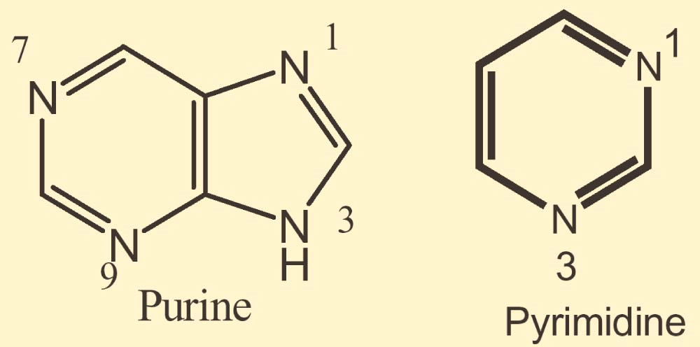
Nitrogenous base
2 types of nitrogenous base- Purine and Pyrimidine
Purine has 4 N’s in a fused-ring structure.
Pyrimidine contains two N’s in a six-membered aromatic ring
NH₂
N
N
N
N
H
Adenine
O
N
N
H
N
N
NH₂
H
Guanine

Slide 5
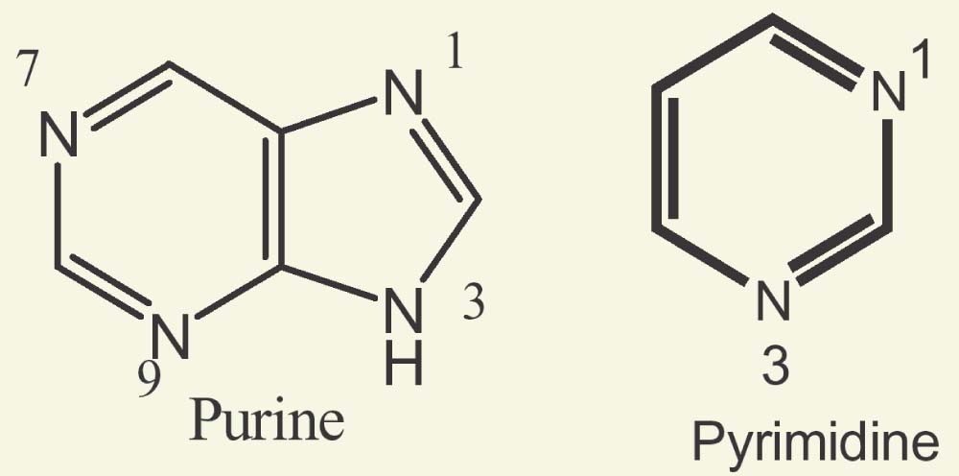
O
H₃C
NH
Thymine
N
O
H
NH₂
N
Cytosine
N
O
H
O
NH
Uracil
N
O
H

Slide 6
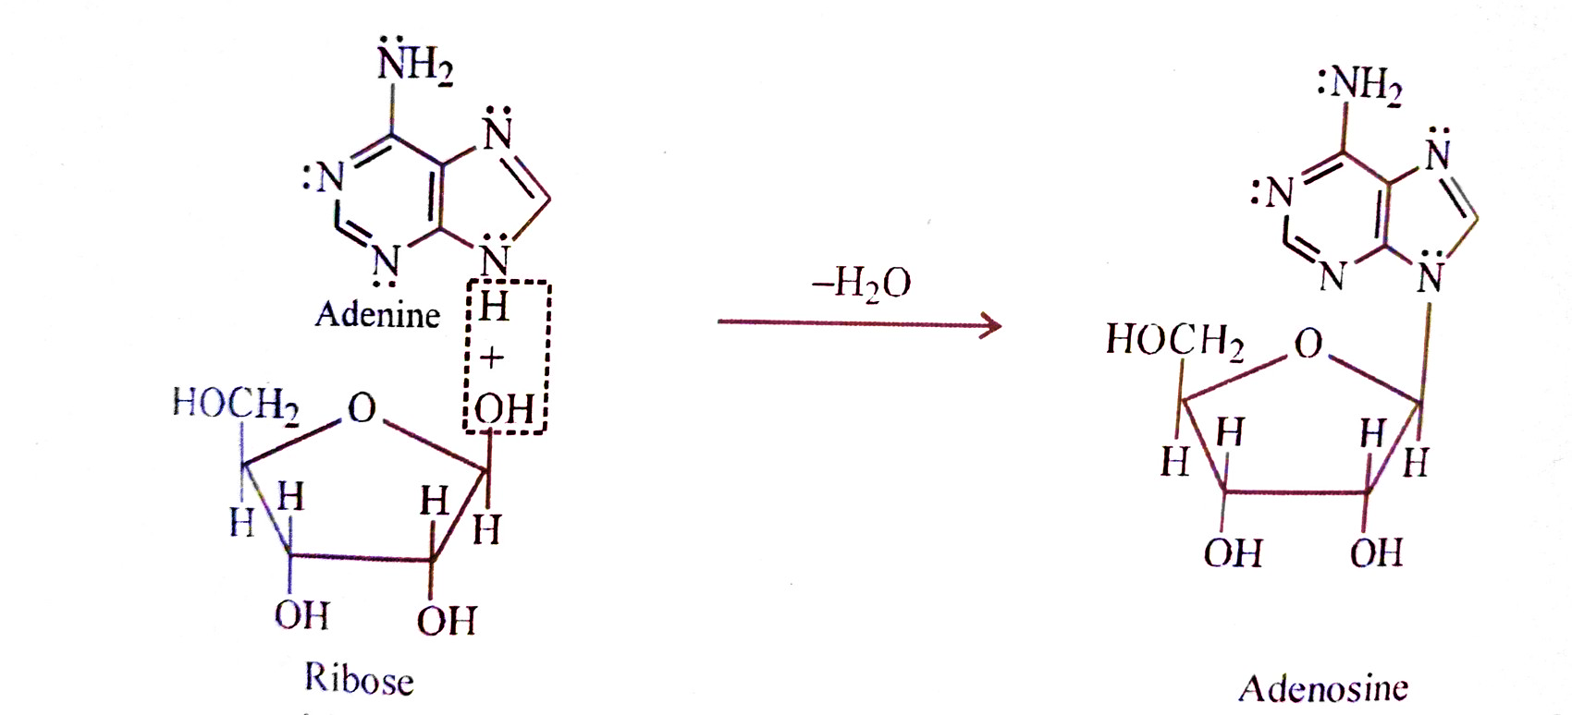
Structure of nucleoside
A nucleoside consists of a nitrogen base and a pentose sugar.
nitrogen base is linked by a glycosidic bond to C1’ of a pentose sugar (ribose or deoxyribose).
Nucleosides are named by changing the nitrogen base ending to -osine for purines and –idine for pyrimidines.
example- adenosine, guanosine, uridine, thymidine, deoxythymine etc.

Slide 7
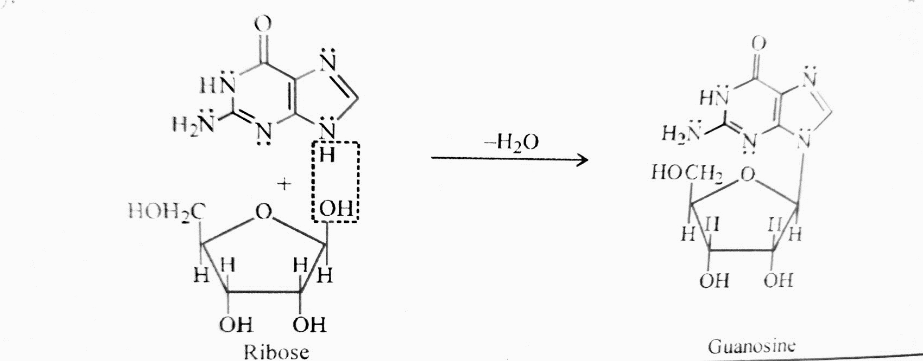
G

Slide 8
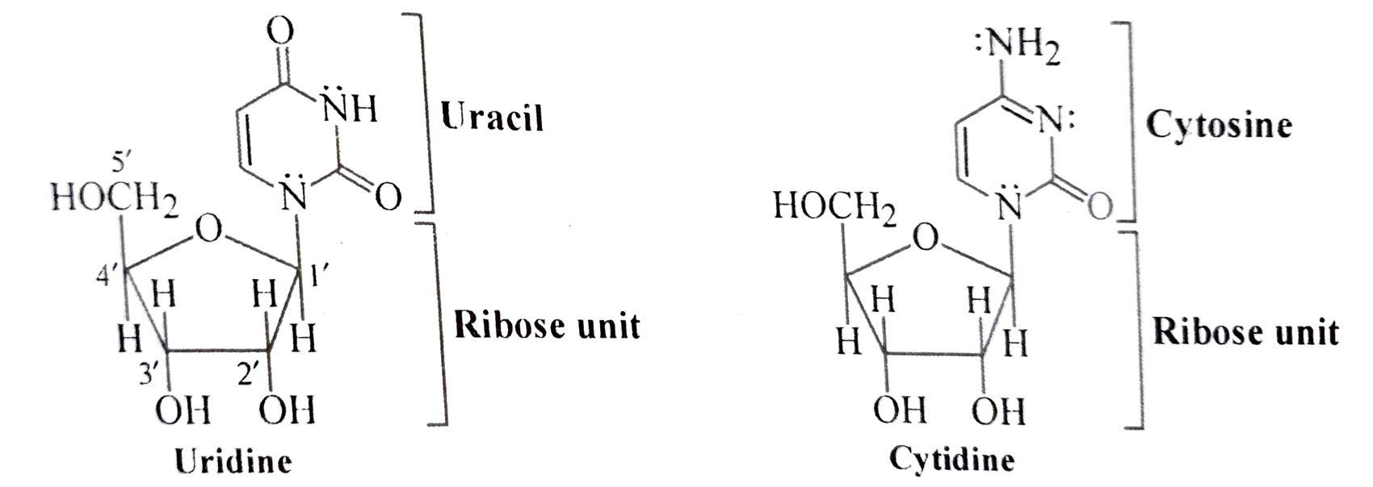
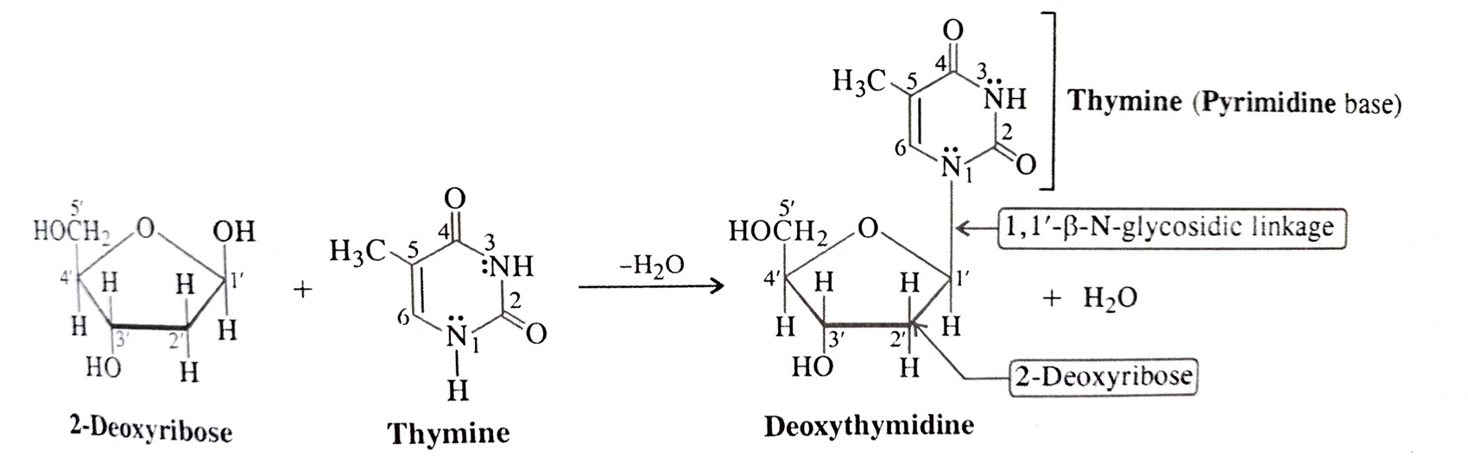

Slide 9
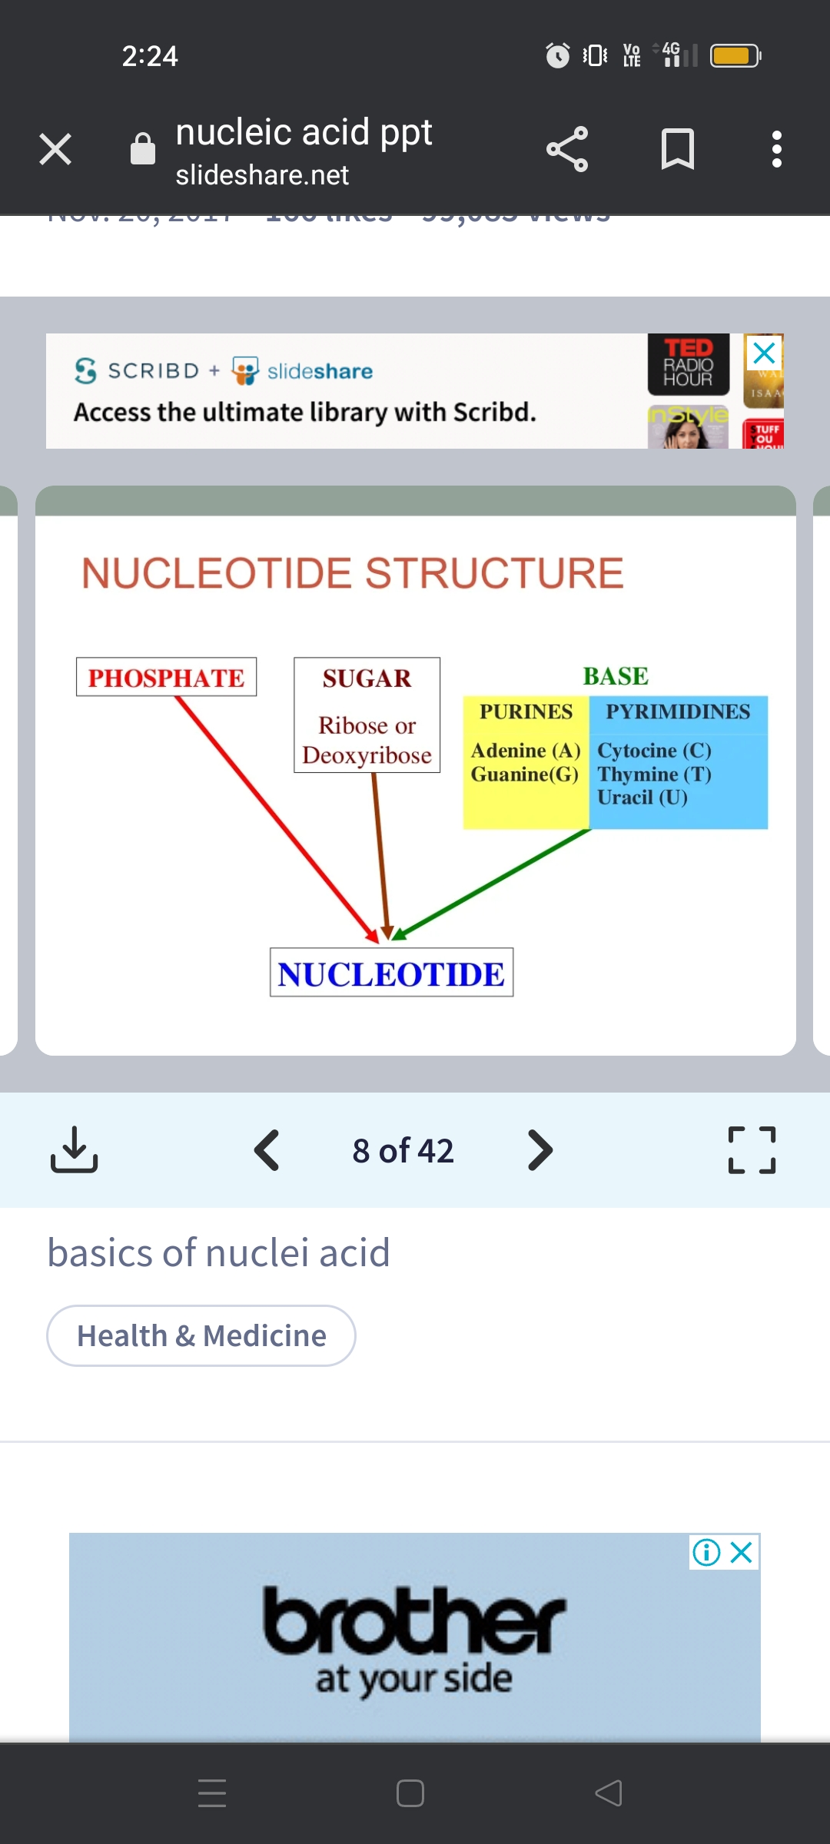
Structure of nucleotide
The phosphoesters of nucleosides are called nucleotides.
Nucleotides can be named in two ways-
a) by changing the –ine or –osine of nucleoside by –ylic acid as adenylic acid, guanylic acid, urinylic acid etc.
b) by adding word phosphate to nucleoside. Example – guanosine 5’-phosphate (GMP), cytidine 5’-phosphate (CMP), deoxyguanosine 5’-phosphate (dGMP).

Slide 10
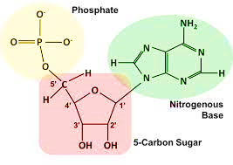
Adenylic Acid (AMP)

Slide 11
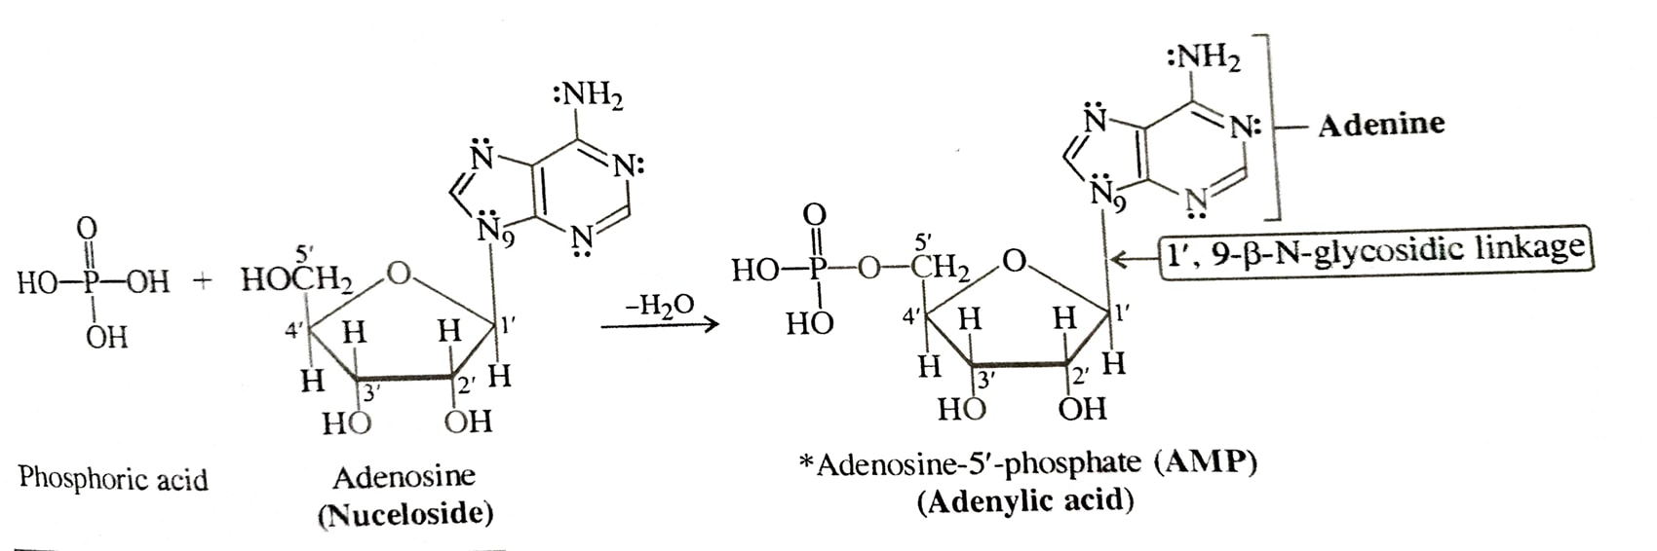
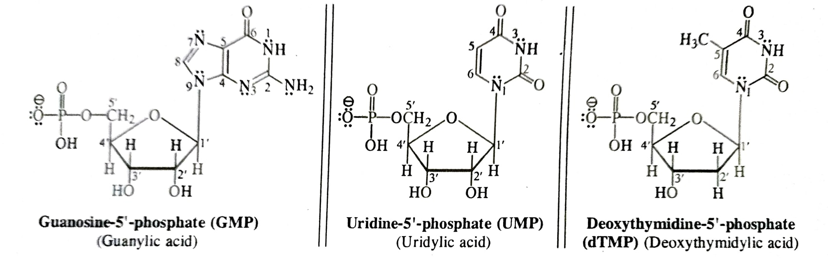

Slide 12
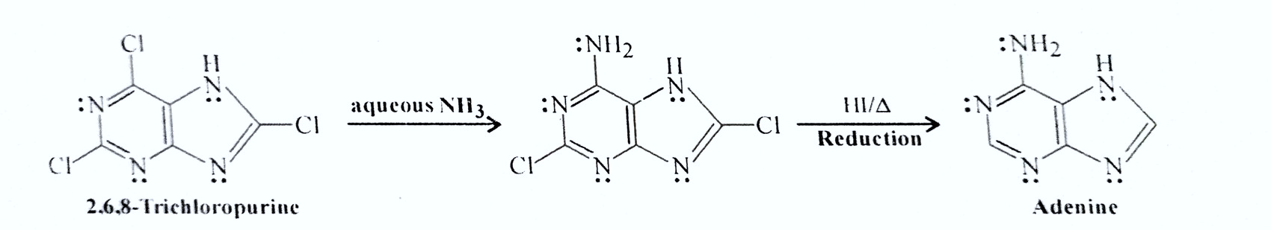
Synthesis of Adenine
Fischer Synthesis-

Slide 13
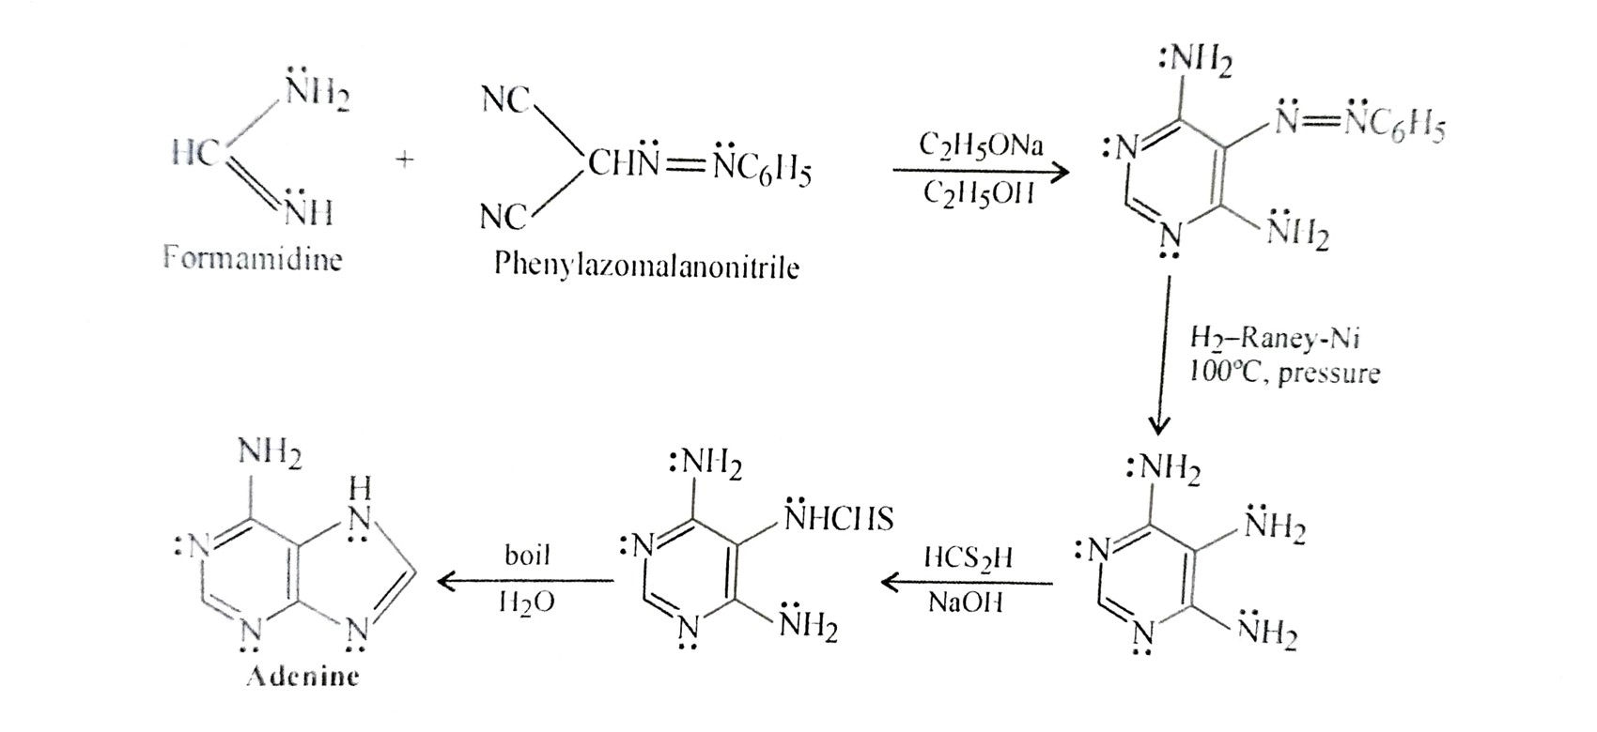
Todel et al-

Slide 14
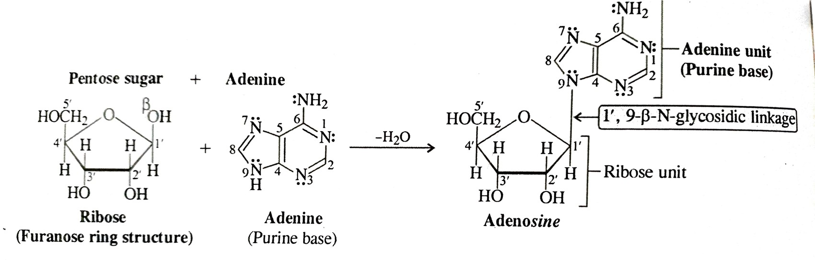
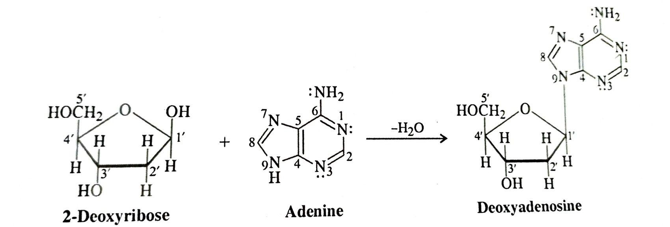
Reactions of Adenine
Formation of Adenosine-
b) Formation of Deoxyadenosine-

Slide 15
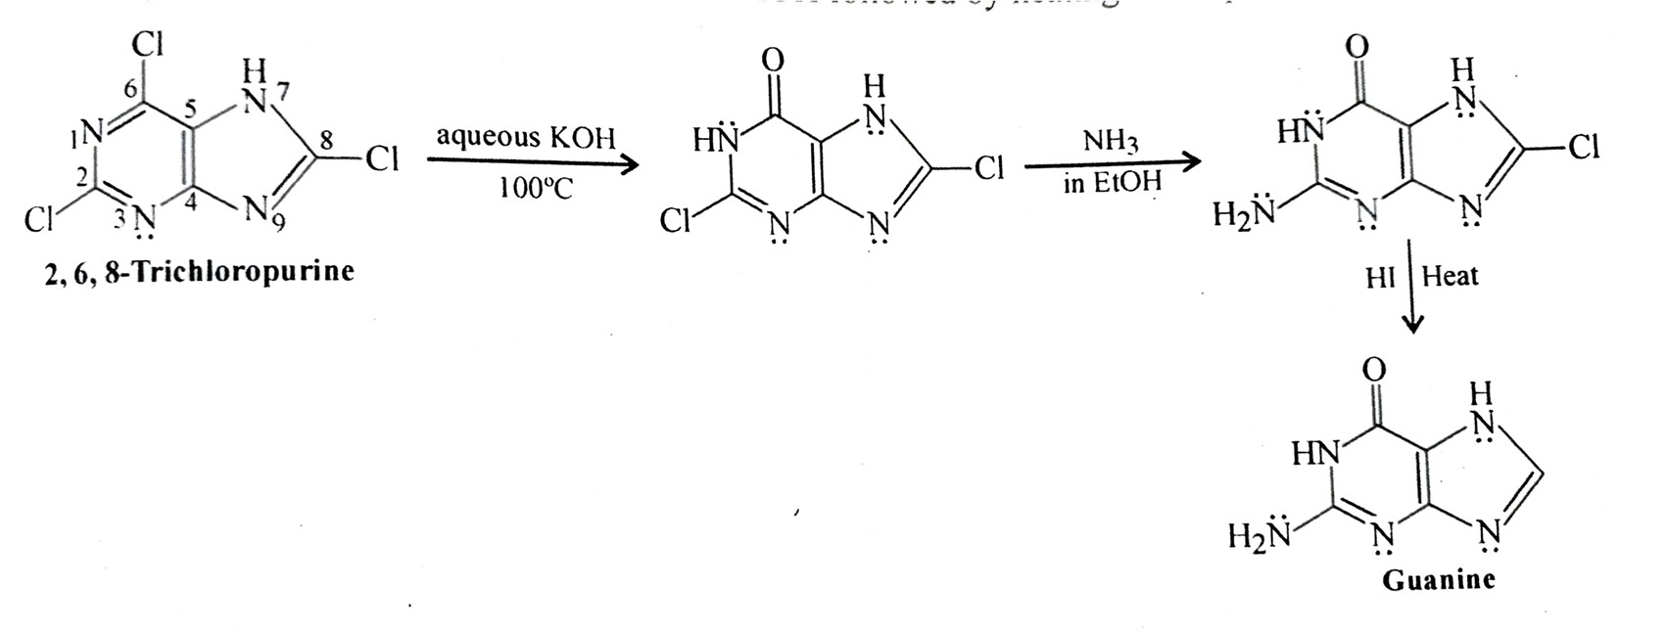
Synthesis of Guanine
a) Fischer method-

Slide 16
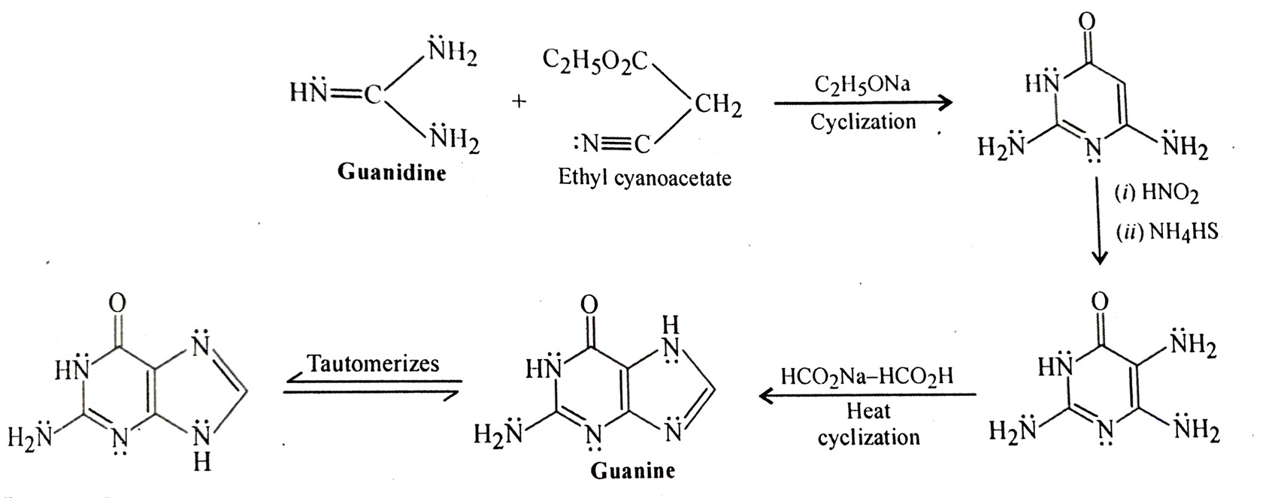
b) Traube method

Slide 17
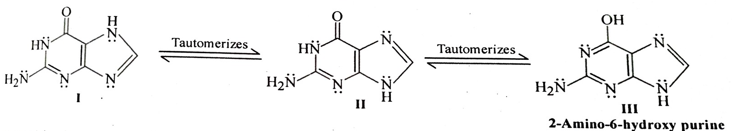
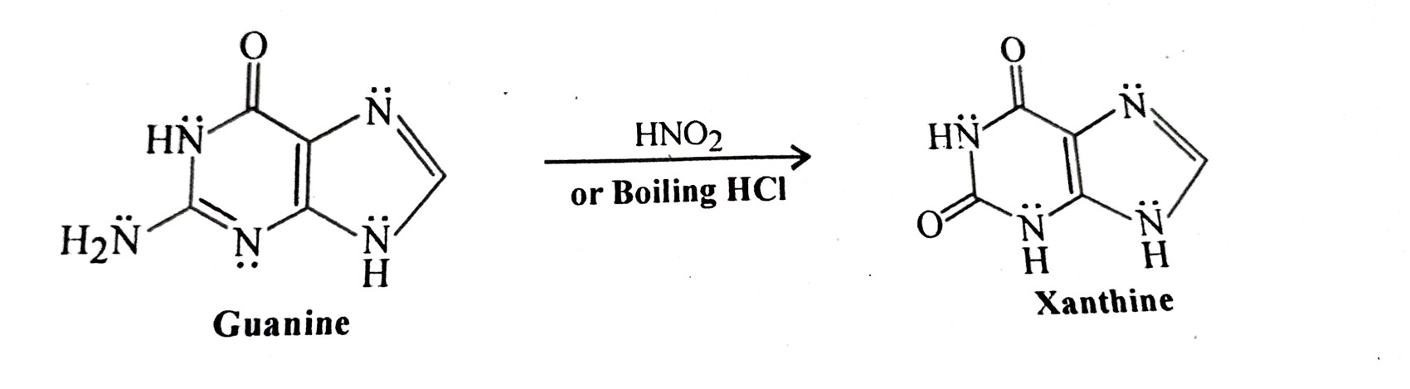
Reactions of Guanine
a) formation of xanthine

Slide 18
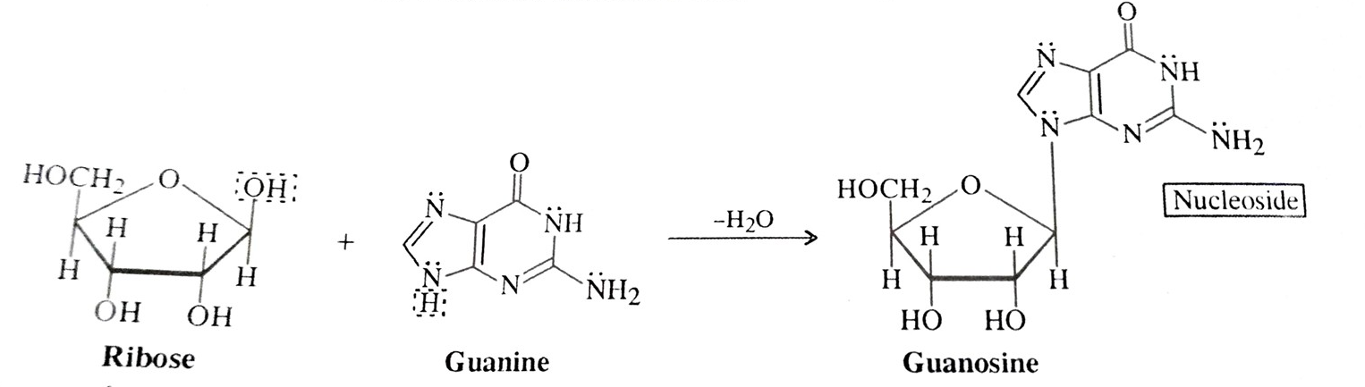
b) Formation of guanosine -
c) Formation of deoxyguanosine

Slide 19
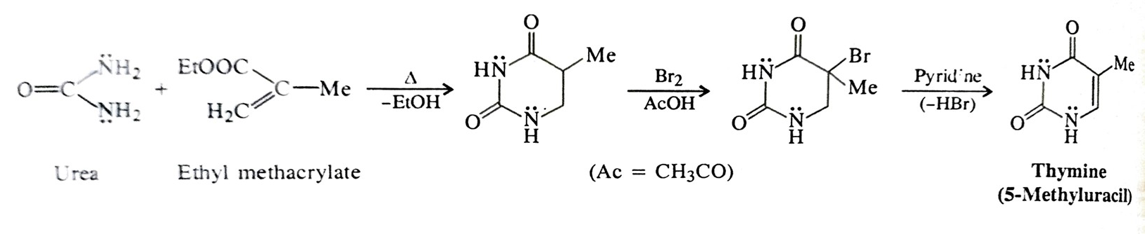
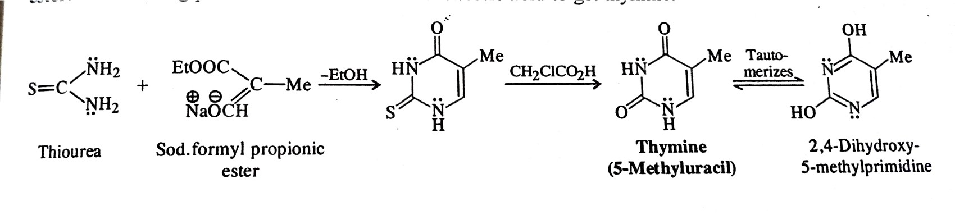
Synthesis of thymine
a) Fischer & Roeder
b) Wheller and Liddle

Slide 20
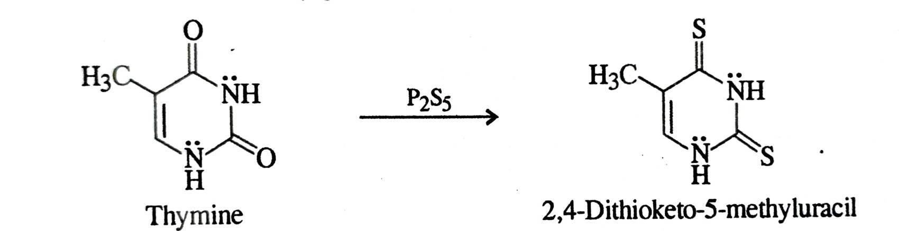
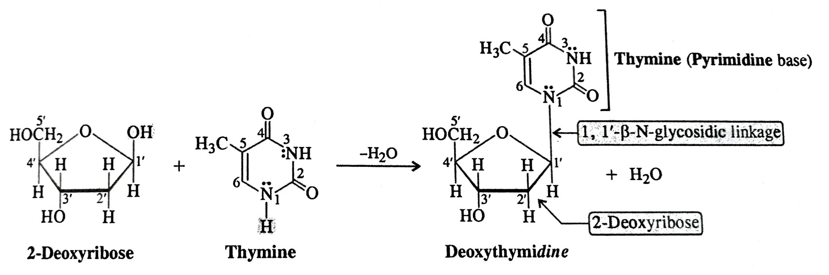
Reactions of thymine
a) Formation of 2,4-dithioketone-5-urancil
b) Formation of Deoxythymine

Slide 21
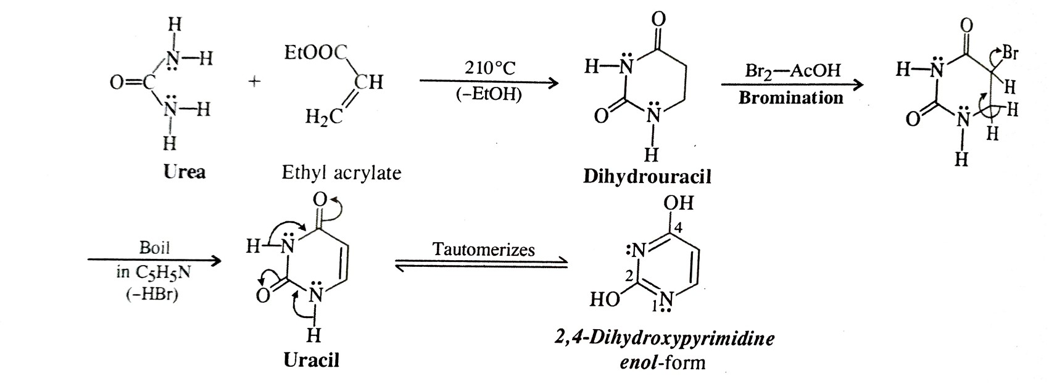
Synthesis of uracil
a) Fischer & Roeder

Slide 22
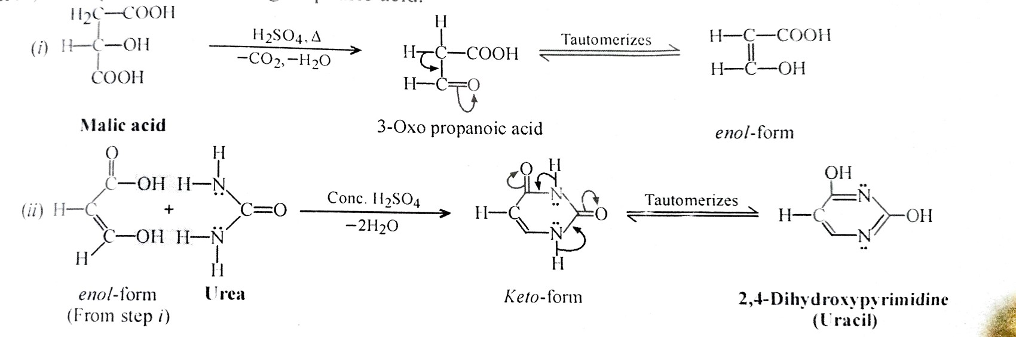
b) From malic acid

Slide 23
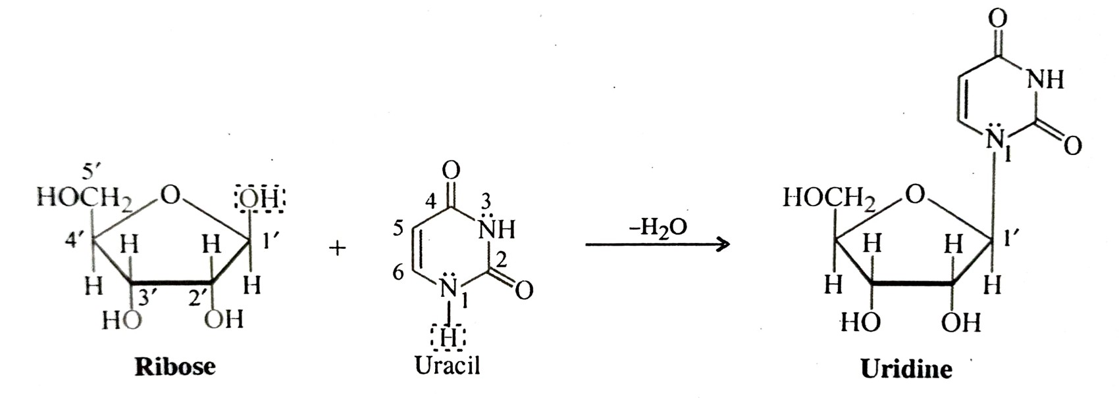
Reactions of uracil
a) Formation of Uridine

Slide 24
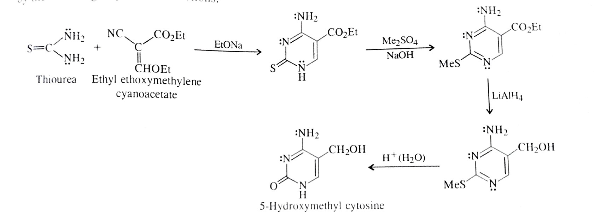
Synthesis of cytosine
a) Ulbricht et al

Slide 25
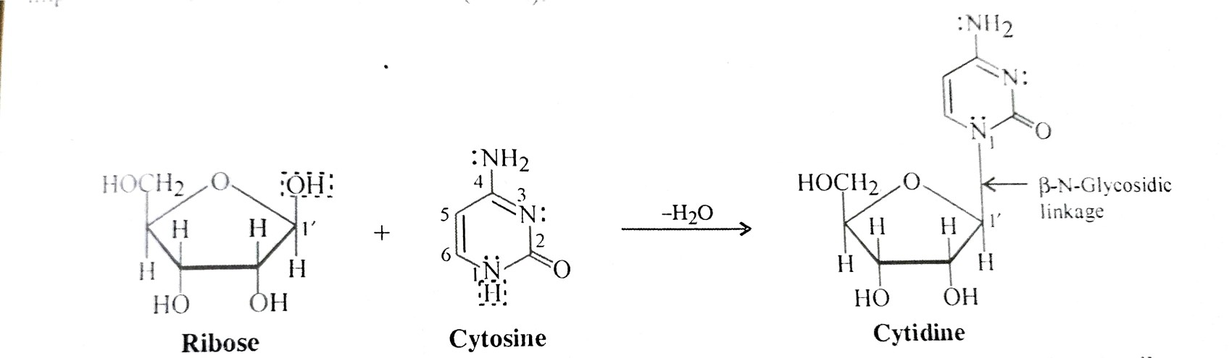
Reactions of cytosine
a) Formation of cytidine
b) Formation of deoxycytidine

Slide 26
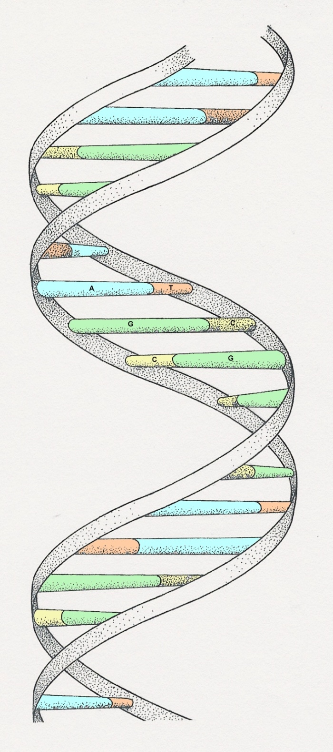
Polynucleotides : DNA & RNA

Slide 27
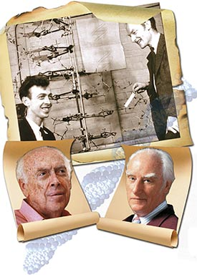
James
Watson
Francis
Crick
Died in 2004

Slide 28
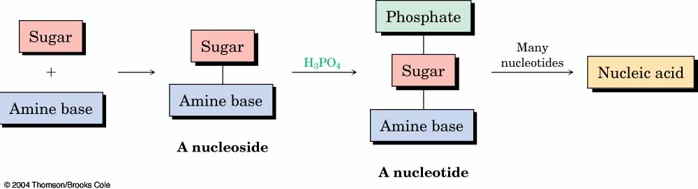
Nucleic Acids and Nucleotides
Deoxyribonucleic acid (DNA) and ribonucleic acid (RNA), are the chemical carriers of genetic information
Nucleic acids are biopolymers made of nucleotides, aldopentoses linked to a purine or pyrimidine and a phosphate
Adenine, guanine, cytosine and thymine are in DNA
RNA contains uracil rather than thymine

Slide 29
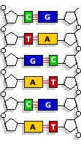
Base Pairing in DNA: The Watson–Crick Model
In 1953 Watson and Crick noted that DNA consists of two polynucleotide strands, running in opposite directions (antiparallel) and coiled around each other in a double helix.
Strands are held together by hydrogen bonds.
Each base is paired with a specific partner:
A is always paired with T
G is always paired with C
The two strands are complimentary and not identical.

Slide 30
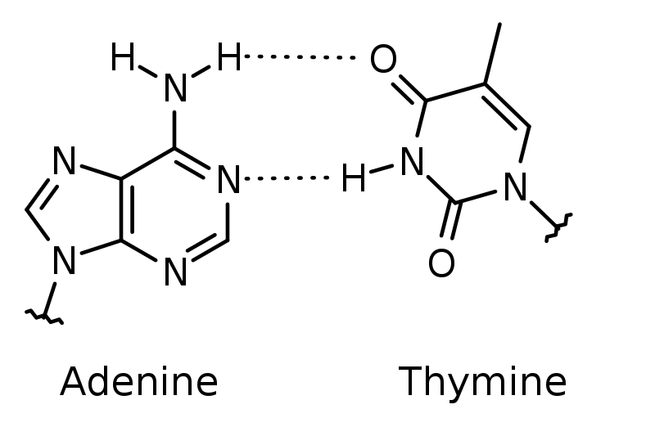
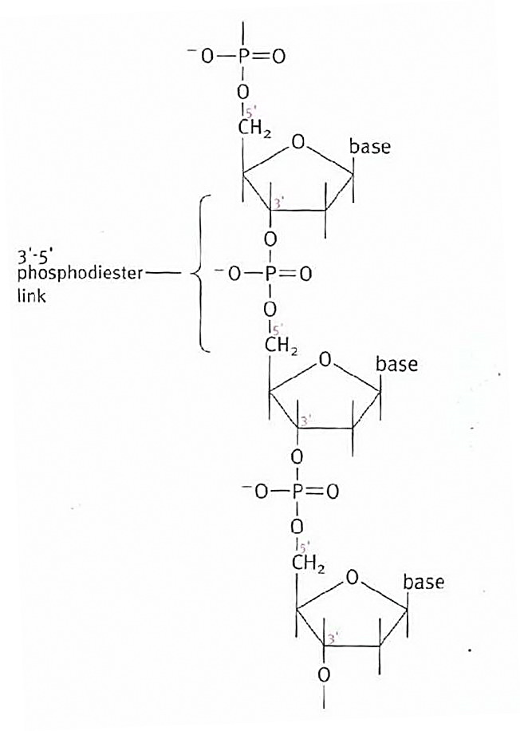
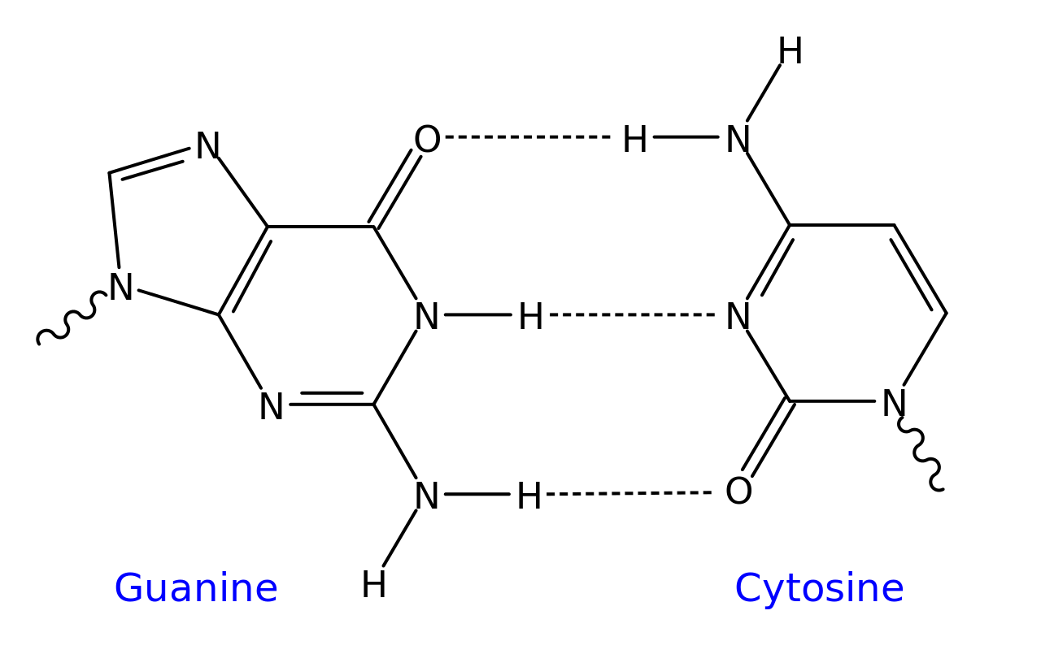

Slide 31
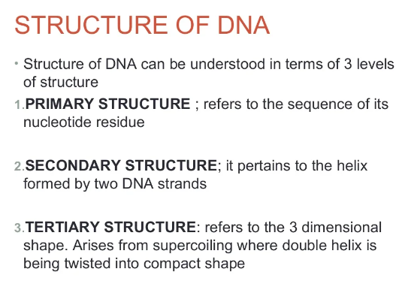
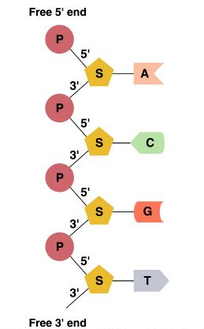
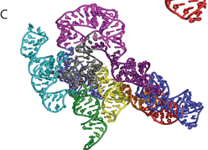

Slide 32
Secondary Structure: DNA Double Helix
In DNA there are two strands of nucleotides that wind together in a double helix
- the strands run in opposite directions
- the bases are arranged in step-like pairs
- the base pairs are held together by hydrogen bonding
The pairing of the bases from the two strands is very specific
The complimentary base pairs are A-T and G-C
- two hydrogen bonds form between A and T
- three hydrogen bonds form between G and C
Each pair consists of a purine and a pyrimidine, so they are the same width, keeping the two strands at equal distances from each other

Slide 33
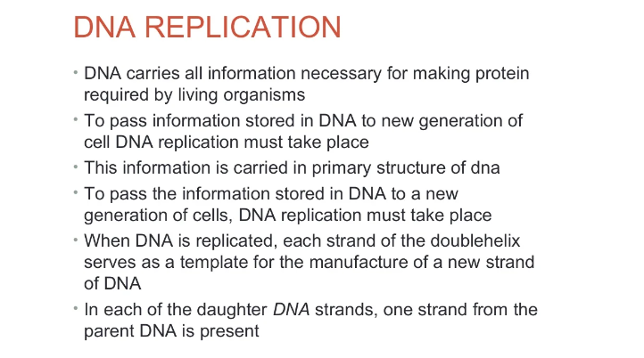
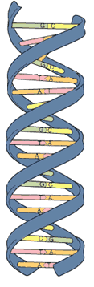
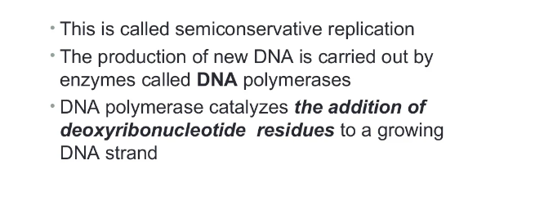
Model of DNA:
The model was developed by Watson and Crick in 1953.
They received a nobel prize in 1962 for their work.
The model looks like a twisted ladder – double helix.

Slide 34
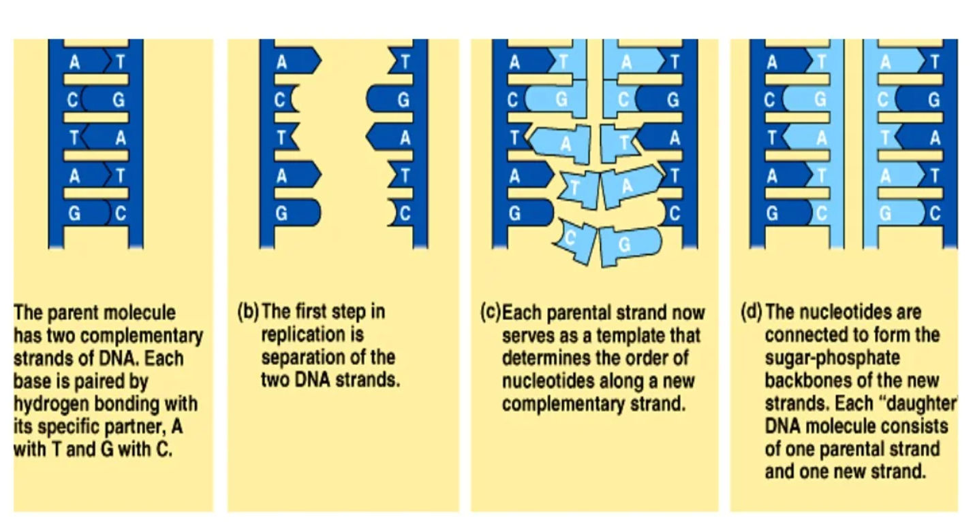
DNA replication -

Slide 35
RNA Nucleotides
Composition ( 3 parts):
1- Ribose sugar (with O in 3rd carbon)
2- Phosphate group
3- One of 4 types of bases (all containing nitrogen):
- Adenine
- Uracyl (only in RNA)
- Cytosine
- Guanine

Slide 36
RNA—Ribonucleic Acid
RNA is a messenger that allows the instruction of DNA to be delivered to the rest of the cell
RNA is different than DNA:
The sugar in RNA is ribose; the sugar in DNA is deoxyribose
RNA is a single strand of nucleotides; DNA is a double strand of nucleotides
RNA has Uracil (U) instead of Thymine (T) which is in DNA
RNA is found inside and outside of the nucleus; DNA is found only inside the nucleus
RNA molecules are much smaller than DNA molecules
There are three main types of RNA:
- ribosomal (rRNA), messenger (mRNA) and transfer (tRNA)

Slide 37
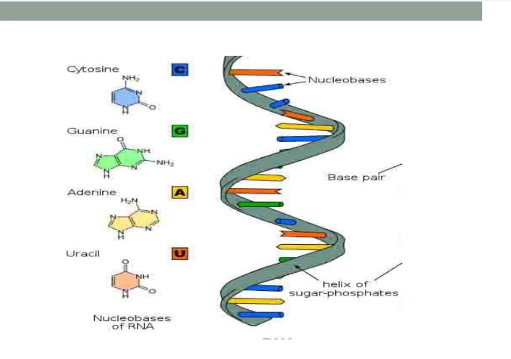

Slide 38
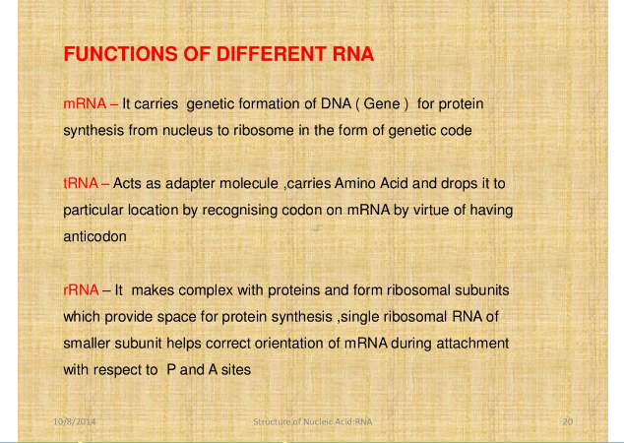

Slide 39
